Slide 1
TBANLT 560 Data Mining Dr Sergio Davalos
Introduction to Data Mining

Slide 2
What is Data Mining?
Data mining is the process of discovering useful patterns and trends in large data sets
Business analytics methods that go beyond counts, descriptive techniques, and methods based on business rules
Focus on advanced data analytics tools – includes
Statistical and machine-learning methods – inform decision making
Change of focus in the underlying business question
What is the relationship between advertising and sales?
To – What specific advertisement or recommended product should be shown to the online shopper at this moment?

Slide 3
Why Data Mining?
Examples
United States 2012 Presidential Elections (source: MIT Technology Review)
First identified likely Obama voters using a data mining model, and then made sure that these voters actually got to the polls
used a separate data mining model to predict the polling outcomes county-by-county
Hamilton, Ohio: the model predicted 56.4% for Obama; actual result was 56.6%, so that the prediction was off by only 0.02%
Bank of America, West Coast customer service call center (source: CIO Magazine)
13 million customers customer calls per month – in the past they all were offered the same products/services
Now, with access to customer’s individual profile, customer service representatives offers new products or services that may be of greatest interest to him/her
Supermarkets
Each cash-register product scan collected helps to build a profile about the shopping habits of your family, and the other families who are checking out

Slide 4
Wanted: Data Miners
“We are drowning in information but starved for knowledge.”
Megatrends, John Naisbitt
We are inundated with data in most fields, but…
There are not enough trained human analysts available who are skilled to convert the data into knowledge
According to McKinsey Report
“There will be a shortage of talent…”
“…particularly of people with deep expertise in statistics and machine learning, and the managers and analysts who know how to operate companies by using insights from big data.”
Demand for talent to exceed supply “…by 140,000 to 190,000 positions”
“… we project a need for 1.5 million additional managers and analysts in the United States”
Factors
Explosive growth in data collection, as in supermarket scanners
Storing the data in data warehouses
Increased access to data from web navigation an intranets
Competitive pressure to increase market share in globalized economy
Growth of computing power and storage capacity

Slide 5
The Need for Human Direction of Data Mining
Some early data mining definitions described process as “automatic”
“…this has misled many people into believing data mining is product that can be bought rather than a discipline that must be mastered.” (Berry, Linoff)
Automation no substitute for human input
Data mining is easy to do badly
Understanding statistical and mathematical model structures of underlying software required
Humans need to be actively involved in every phase of data mining process
Task of data mining should be integrated into human process of problem solving

Slide 6
Cross Industry Standard Process: CRISP-DM
Cross-Industry Standard Process for Data Mining (CRISP-DM) developed in 1996
Fits data mining into the general problem-solving strategy of business/research unit
Contributors include DaimlerChrysler, SPSS, and NCR
Industry, tool and application neutral
Non-proprietary and freely available
Data mining projects follow iterative, adaptive life cycle consisting of 6 phases
Phase sequences are adaptive

Slide 7
Cross Industry Standard Process: CRISP-DM (cont’d)
Iterative CRIP-DM process shown in outer circle
Most significant dependencies between phases shown
Next phase depends on results from preceding phase
Returning to earlier phase possible before moving forward
Business / Research Understanding Phase
Data Understanding Phase
Deployment Phase
Data Preparation Phase
Evaluation Phase
Modeling Phase
CRISP-DM Lifecycle

Slide 8
Cross Industry Standard Process: CRISP-DM (cont’d)
(1) Business/Research Understanding Phase
Define project requirements and objectives
Translate objectives into data mining problem definition
Prepare preliminary strategy to meet objectives
(2) Data Understanding Phase
Collect data
Perform exploratory data analysis (EDA)
Assess data quality
Optionally, select interesting subsets
(3) Data Preparation Phase
Prepares for modeling in subsequent phases
Select cases and variables appropriate for analysis
Cleanse and prepare data so it is ready for modeling tools
Perform transformation of certain variables, if needed

Slide 9
Cross Industry Standard Process: CRISP-DM (cont’d)
(4) Modeling Phase
Select and apply one or more modeling techniques
Calibrate model settings to optimize results
If necessary, additional data preparation may be required for supporting a particular technique
(5) Evaluation Phase
Evaluate one or more models for effectiveness
Determine whether defined objectives achieved
Establish whether some important facet of the problem has not been sufficiently accounted for
Make decision regarding data mining results before deploying to field

Slide 10
Cross Industry Standard Process: CRISP-DM (cont’d)
(6) Deployment Phase
Make use of models created
Simple deployment example: generate report
Complex deployment example: implement parallel data mining effort in another department
In businesses, customer often carries out deployment based on your model

Slide 11
Fallacies of Data Mining
Four Fallacies of Data Mining (Louie, Nautilus Systems, Inc.)
 | Fallacy | Reality
1 | Set of tools can be turned loose on data repositories Finds answers to all business problems | No automatic data mining tools solve problems Rather, data mining is process (CRISP-DM) Integrates into overall business objectives
2 | Data mining process is autonomous Requires little oversight | Requires significant intervention during every phase After model deployment, new models require updates Continuous evaluative measures monitored by analysts
3 | Data mining quickly pays for itself | Return rates vary Depending on startup, personnel, data preparation costs, etc.
4 | Data mining software easy to use | Ease of use varies across projects Analysts must combine subject matter knowledge with specific problem domain

Slide 12
Fallacies of Data Mining (cont’d)
Other Fallacies of Data Mining (Larose)
 | Fallacy | Reality
5 | Data mining identifies causes of business problems | Knowledge discovery process uncovers patterns of behavior Humans interpret results and identify causes
6 | Data mining automatically cleans data in databases | Data mining often uses data from legacy systems Data possibly not examined or used in years Organizations starting data mining efforts confronted with huge data preprocessing task
7 | Data mining always provides positive results. | There is no guarantee of positive results But used properly, data mining can provide actionable and highly profitable results.

Slide 13
What Tasks Can Data Mining Accomplish?
Six common data mining tasks
Description
Estimation
Prediction
Classification
Clustering
Association

Slide 14
What Tasks Can Data Mining Accomplish? (cont’d)
Description
Describes patterns or trends in data
For example, pollster may uncover patterns suggesting those laid-off less likely to support incumbent
Descriptions of patterns, often suggest possible explanations
For example, those laid-off now less financially secure; therefore, prefer alternate candidate
Data mining models should be transparent
That is, results should be interpretable by humans
Some data mining methods more transparent than others
For example, Decision Trees (transparent) > Neural Networks (opaque)
High-quality description accomplished using Exploratory Data Analysis (EDA)
Graphical method of exploring patterns and trends in data

Slide 15
What Tasks Can Data Mining Accomplish? (cont’d)
Estimation (1/3)
Similar to Classification task, except target variable is numeric
Models built from complete data records
Records include values for each predictor field and numeric target variable in training set
For new observations, estimate the target variable
Example: Estimate a patient’s systolic blood pressure, based on patient’s age, gender, body-mass index, and sodium levels
Use training data to develop model that estimates systolic blood pressure based on predictor variables
Apply model to new cases, to obtain estimated systolic blood pressure

Slide 16
What Tasks Can Data Mining Accomplish? (cont’d)
Estimation (2/3) – Further examples
Estimate amount of money, family of four will spend on back-to-school shopping
Estimate percentage decrease in rotary movement sustained to NFL player with knee injury
Estimate number of points basketball player scores when double-teamed in playoffs
Estimate GPA of graduate student, based on student’s undergraduate GPA
Statistical Analysis uses several estimation methods: point estimation, confidence interval estimation, linear regression and correlation, and multiple regression

Slide 17
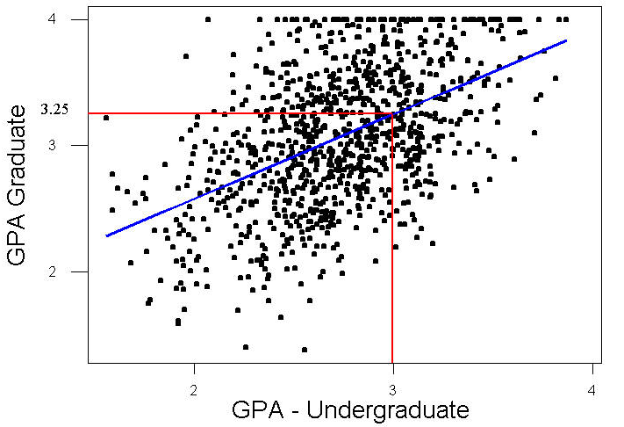
What Tasks Can Data Mining Accomplish? (cont’d)
Estimation (3/3) – continued
Figure 1.2 shows scatter plot of graduate GPA against undergraduate GPA (1000 students)
Linear regression finds line (blue) best approximating relationship between two variables
Regression line estimates student’s graduate GPA based on their undergraduate GPA, resulting in the following model:
ŷ = 1.24 + 0.67x
For example, suppose student’s undergraduate GPA = 3.0
According to estimation model, estimated student’s graduate GPA = 1.24 + 0.67(3.0) = 3.25
Point (x = 3.0, ŷ = 3.25) lies on regression line

Slide 18
What Tasks Can Data Mining Accomplish? (cont’d)
Prediction
Similar to classification and estimation, except results lie in the future
Methods used for classification and prediction applicable to prediction
Includes point estimation, confidence interval estimation, linear regression and correlation, multiple regression, k-nearest neighbor, decision trees and neural networks
Example prediction tasks in business and research:
Predict price of stock 3 months into future, based on past performance
Predict percentage increase in traffic deaths next year, if speed limit increased
Predicting the winner of this fall’s World Series, based on a comparison of the team statistics
Predict whether molecule in newly discovered drug leads to profitable pharmaceutical drug
?
Stock Price
?
?
Q1
Q2
Q3
Q4

Slide 19
What Tasks Can Data Mining Accomplish? (cont’d)
Classification (1/5)
Similar to Estimation task, except target variable is categorical
Models built from complete data records
Records include values for each predictor field and categorical target variable in training set (rather than numeric)
For new observations, estimate the target variable
Example: Classify the Income Bracket of an individual as Low, Middle or High based their Age, Gender and Occupation
Use training data to develop model that classifies Income Bracket based on predictor variables
Apply model to cases not currently in the database, to obtain estimated Income Bracket classification

Slide 20
What Tasks Can Data Mining Accomplish? (cont’d)
Classification (2/5) – Example in detail
Using the training data set, the algorithm would:
Examine the data set containing both the predictor variables and the (already classified) target variable, income bracket
Algorithm (software) “learns about” which combinations of variables are associated with which income brackets (for example, Older females -> High Income)
Then, when looking at new records with no income information, the algorithm would:
Based in the classification in the training set, would assign classifications to the new records (for example, 63-year-old female professor -> high)
Subject | Age | Gender | Occupation | Income Bracket
001 | 47 | F | Software Engineer | High
002 | 28 | M | Marketing Consultant | Middle
003 | 35 | M | Unemployed | Low
… | … | … | … | …

Slide 21
What Tasks Can Data Mining Accomplish? (cont’d)
Classification (3/5) – Further examples in Business and Research
Determining whether a particular credit card transaction is fraudulent
Placing a new student into a particular track with regard to special needs
Assessing whether a mortgage application is a good or bad credit risk
Diagnosing whether a particular disease is present
Determining whether a will was written by the actual deceased, or fraudulently by someone else,
Identifying whether or not certain financial or personal behavior indicates a possible terrorist threat

Slide 22
What Tasks Can Data Mining Accomplish? (cont’d)
Classification (4/5) – The drug prescription example
Interested in classifying the type of drug a patient should be prescribed, based on age of the patient, and the patient’s sodium / potassium ratio
Next slide presents scatter plot of 200 patients with their sodium/potassium ratios against age, and the particular drug prescribed by the shade of the points
What drug should be prescribed for:
Young patient with high Na/K ratio?
Young patients with high Na/K are in the upper left region
Past patients in this region got Drug Y
The recommended classification for such patients is Drug Y
Older patient with low Na/K ratio?
Lower right region
Past patients in this region got either dark gray (Drugs B or C) or medium gray (Drugs A or X).
Definitive classification not possible without further information

Slide 23
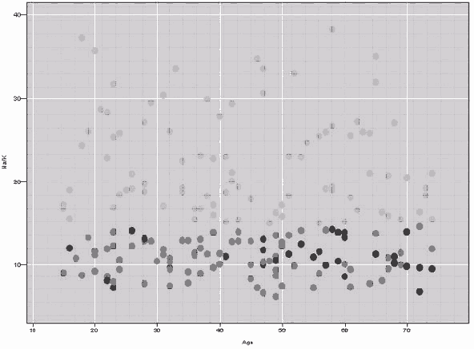
Figure 1.3 - Which Drug Should Be Prescribed for Which Type of Patient?
Na / K (sodium / potassium ratio)
Age
Dot Legend:
Light gray – Drug Y
Medium gray – Drugs A or X
Dark gray – Drugs B or C

Slide 24
What Tasks Can Data Mining Accomplish? (cont’d)
Classification (5/5) – Handling many predictors
Classification tasks with 2 or 3 predictors
Can be analyzed using charts and plots like the drug example above
Many datasets have multiple predictors
This requires common data mining methods for classification like:
k-nearest neighbor
decision trees
neural networks

Slide 25
What Tasks Can Data Mining Accomplish? (cont’d)
Clustering (1/2)
Refers to grouping records into classes of similar objects
Cluster – a collection of records similar to one another, and dissimilar to records in other clusters
Clustering algorithm seeks to segment data set into homogeneous subgroups
Target variable not specified
Clustering does not try to classify/estimate/predict target variable
For example, Claritas, Inc. PRIZM software clusters demographic profiles for different geographic areas according to zip code
It describes every American zip code area in terms of distinct lifestyle types (see next slide for example)

Slide 26
Nielsen Claritas’ PRIZM segmentation system
01 Upper Crust | 02 Blue Blood Estates | 03 Movers and Shakers
04 Young Digerati | 05 Country Squires | 06 Winner’s Circle
07 Money and Brains | 08 Executive Suites | 09 Big Fish, Small Pond
10 Second City Elite | 11 God’s Country | 12 Brite Lites, Little City
13 Upward Bound | 14 New Empty Nests | 15 Pools and Patios
16 Bohemian Mix | 17 Beltway Boomers | 18 Kids and Cul-de-sacs
19 Home Sweet Home | 20 Fast-Track Families | 21 Gray Power
22 Young Influentials | 23 Greenbelt Sports | 24 Up-and-Comers
25 Country Casuals | 26 The Cosmopolitans | 27 Middleburg Managers
28 Traditional Times | 29American Dreams | 30 Suburban Sprawl
31 Urban Achievers | 32 New Homesteaders | 33 Big Sky Families
34 White Picket Fences | 35 Boomtown Singles | 36 Blue-Chip Blues
37 Mayberry-ville | 38 Simple Pleasures | 39 Domestic Duos
40 Close-in Couples | 41 Sunset City Blues | 42 Red, White and Blues
43 Heartlanders | 44 New Beginnings | 45 Blue Highways
46 Old Glories | 47 City Startups | 48 Young and Rustic
49 American Classics | 50 Kid Country, USA | 51 Shotguns and Pickups
52 Suburban Pioneers | 53 Mobility Blues | 54 Multi-Culti Mosaic
55Golden Ponds | 56 Crossroads Villagers | 57 Old Milltowns
58 Back Country Folks | 59 Urban Elders | 60 Park Bench Seniors
61 City Roots | 62 Hometown Retired | 63 Family Thrifts
64 Bedrock America | 65 Big City Blues | 66 Low-Rise Living
Clusters for zip code 90210, Beverly Hills, California are:
#01: Upper Crust Estates
#03: Movers and Shakers
#04: Young Digerati
#07: Money and Brains
#16: Bohemian Mix
The description for Cluster # 01: Upper Crust
The nation’s most exclusive address
the wealthiest lifestyle in America
Haven for empty-nesting couples between the ages of 45 and 64
highest concentration of residents with:
over $100,000/year
Most opulent standard of living.
Table 1.2 The 66 clusters used by the PRIZM segmentation system.

Slide 27
What Tasks Can Data Mining Accomplish? (cont’d)
Clustering (2/2) - Clustering Tasks in Business and Research:
Target marketing niche product for small business that does not have large marketing budget
For accounting purposes, to segmentize financial behavior into benign and suspicious categories
Use as dimensionality-reduction tool for data set having several hundred inputs
For gene expression clustering, where very large quantities of genes may exhibit similar behavior
As preliminary step in data mining
Resulting clusters used as input to different technique downstream, such as neural networks
See more about hierarchical and k-means clustering in Chapter 10, and Kohonen networks in Chapter 11

Slide 28
What Tasks Can Data Mining Accomplish? (cont’d)
Association (1/2)
Find out which attributes “go together”
Commonly used for Market Basket Analysis (aka Affinity Association)
Quantify relationships between two or more attributes in the form of rules as:
IF antecedent THEN consequent
Rules measured using support and confidence
Example: A particular supermarket might find that:
Thursday night 200 of 1,000 customers bought diapers, and of those buying diapers, 50 purchased beer
Association Rule: “IF buy diapers, THEN buy beer”
Support = 200/1,000 = 5%, and confidence = 50/200 = 25%

Slide 29
What Tasks Can Data Mining Accomplish? (cont’d)
Association (2/2) - Association Tasks in Business and Research:
Investigating the proportion of subscribers to your company’s cell phone plan that respond positively to an offer of an service upgrade,
Examining the proportion of children whose parents read to them who are themselves good readers,
Predicting degradation in telecommunications networks,
Finding out which items in a supermarket are purchased together, and which items are never purchased together,
Determining the proportion of cases in which a new drug will exhibit dangerous side effects.
The a priori and the GRI association rule algorithms are visited in Chapter 12

